Slide 1

Final Words

Slide 2

Template- driven
Reactive

Slide 3
Angular Forms
Template-driven
Easy to use
Similar to AngularJS
Two-way data binding -> Minimal component code
Automatically tracks form and
input element state
Reactive
More flexible ->
more complex scenarios
Immutable data model
Easier to perform an action on a value change
Reactive transformations -> DebounceTime or DistinctUntilChanged
Easily add input elements dynamically Easier unit testing

Slide 4
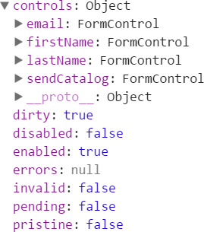


Template-driven
public firstName = 'Jack', public lastName = 'Harkness', public email = '',
public sendCatalog = false,
Reactive
public firstName = 'Jack', public lastName = 'Harkness', public email = '',
public sendCatalog = false,

Slide 5



Slide 6


Slide 7


Slide 8
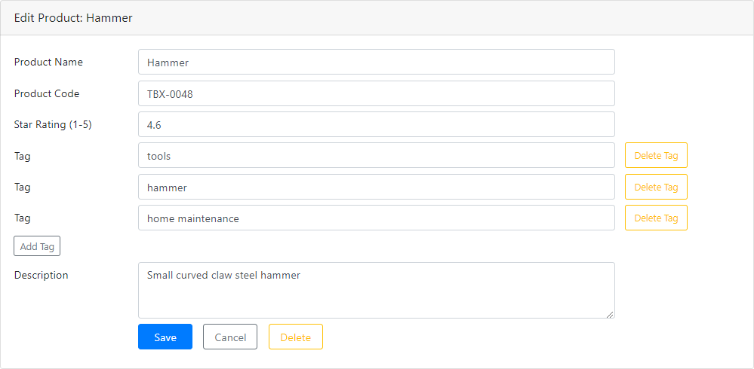

Slide 9


Slide 10


Sending an HTTP Request
Product Data Service
Request (Get) Response | Http Service | Request (GET)
 |  | Response
Web Server

Slide 11

Checklist
Steps and tips
Revisit as you build

Slide 12

Learning More
Angular Documentation
Angular.io

Slide 13
Template- driven
Reactive

